Slide 1


PERCEPTIONS, INTERACTIONS
AND COMFORT LEVEL OF THE
HETEROSEXUAL CISGENDER POPULATION
WITH SEXUAL MINORITIES
RESEARCH REPORT PREPARED FOR:
FONDATION JASMIN ROY

Slide 2
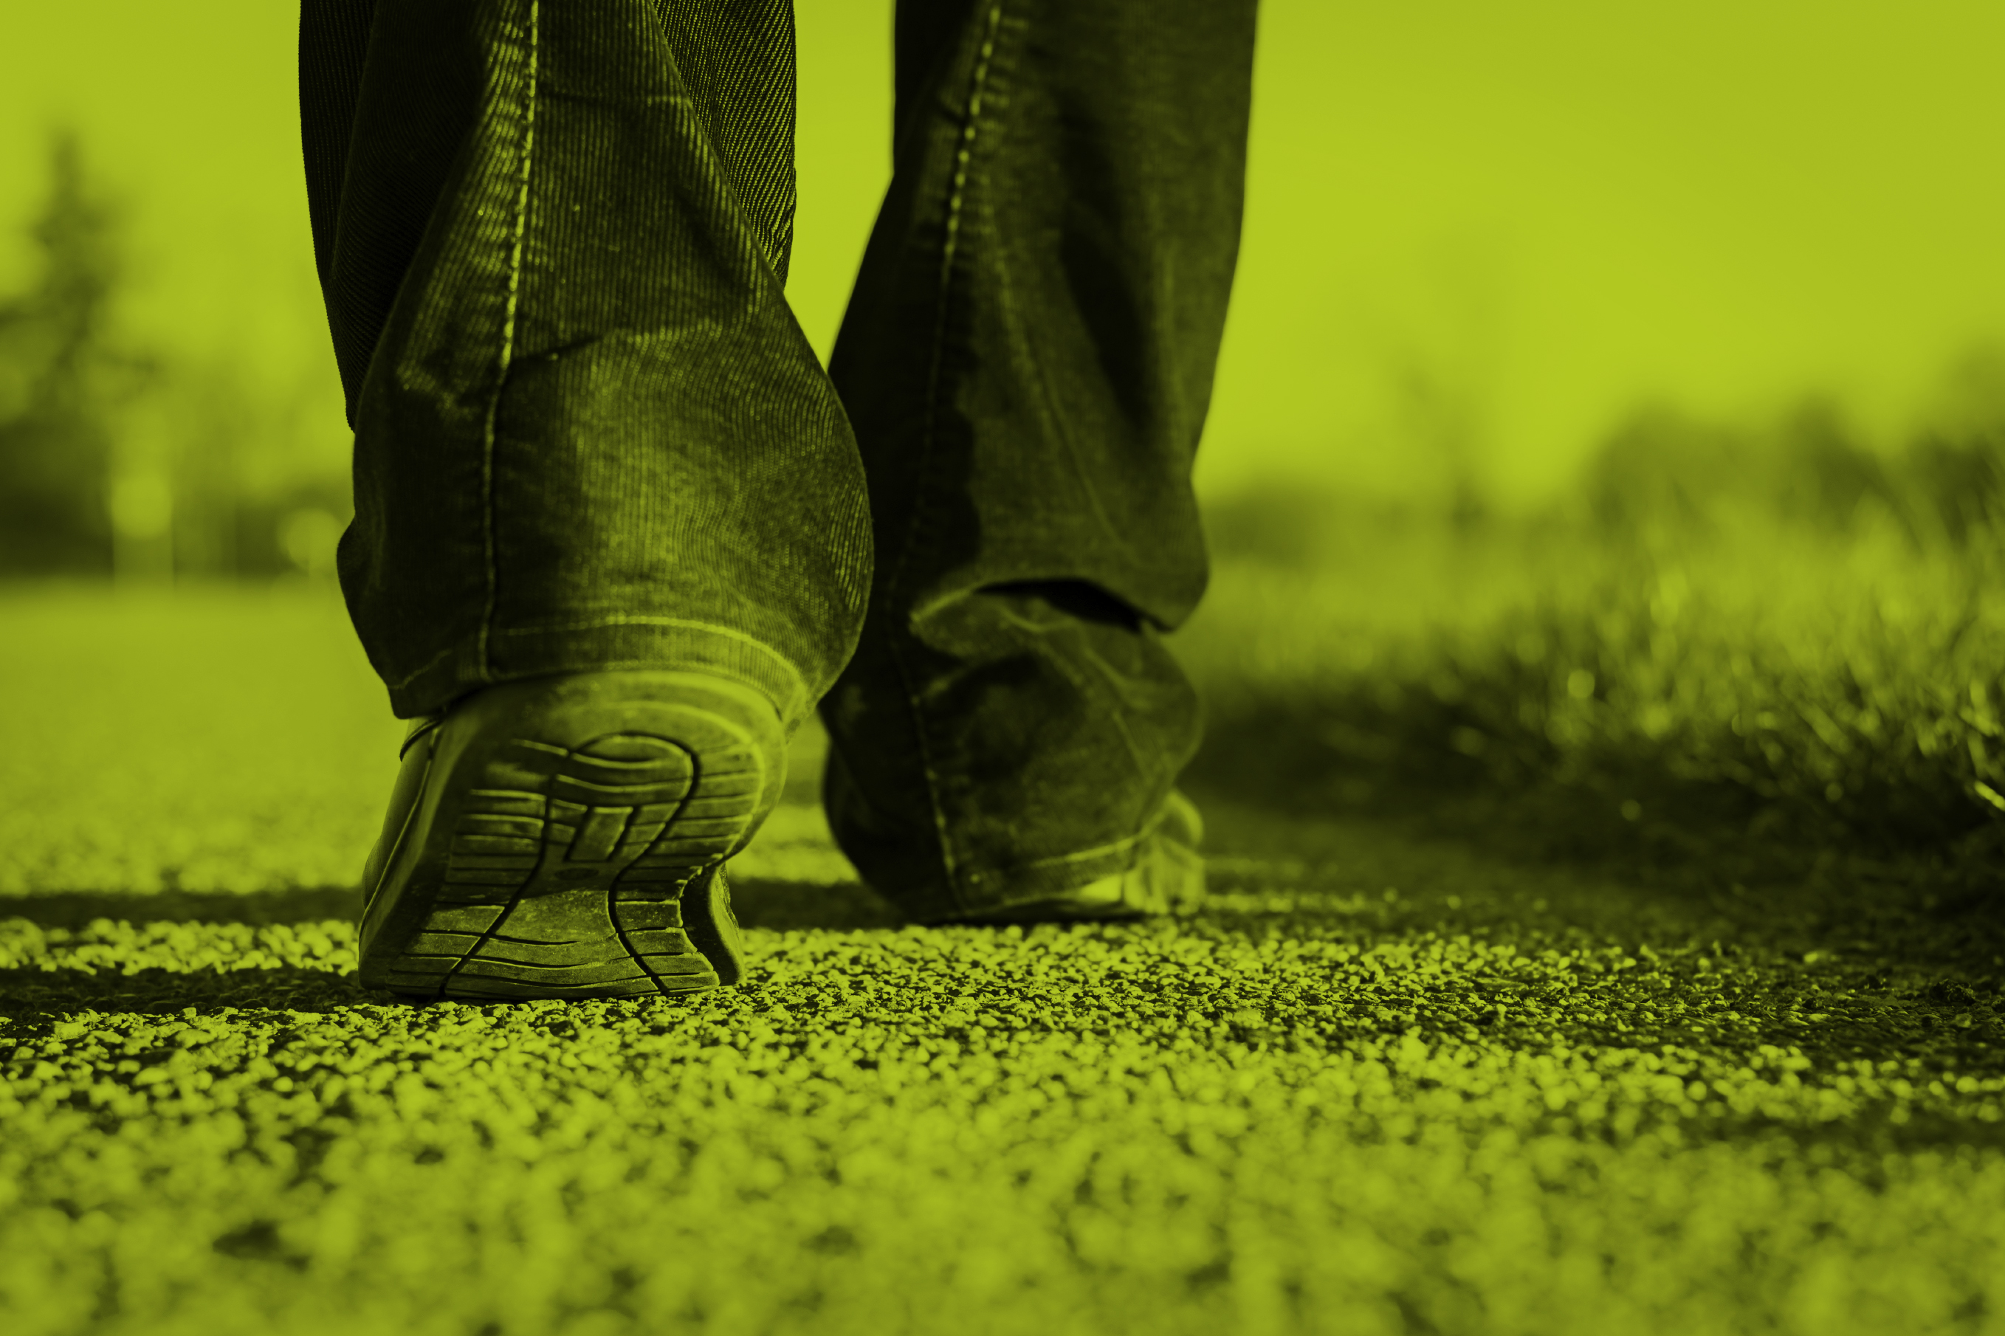
Context and methodology
REPORT PREPARED FOR FONDATION JASMIN ROY

Slide 3
Context
Fondation Jasmin Roy commissioned CROP to conduct a study of the members of LGBT communities in Canada in order to take stock of their current realities as well as determine their specific values and needs.
This project was made possible through the contributions of Québec’s Ministry of Justice under “The Fight Against Homophobia” program, of the Royal Bank of Canada, the City of Montreal, the Government of Canada, the Government of New Brunswick and the Government of
Nova Scotia.
The results of this research study will feed the reflections of the relevant organizations and various levels of government toward the implementation of action plans to better meet the needs of LGBT youth, promote social environments that are more positive, friendly and supportive of their difference, and pave the way to a smoother integration in the workplace.
One of the overarching objectives of the survey was to identify the distinctive needs of the younger LGBT generation as well as those expressed by the various segments in this group (based on region, sexual orientation, gender identity, cultural background etc.).
In addition, the survey included a separate section targeting heterosexual cisgender people, a phase of the study that served two objectives:
Compare some of their behaviours, values and attitudes in life to those expressed by the members of LGBT communities – results detailed in a separate report
Measure some of their perceptions of LGBT communities – results detailed in this report

Slide 4
Methodology – General public phase
Data collection
The data collection operations were conducted from April 11 to 19, 2017 via web panel (Asking Canadians).
In total, 800 questionnaires were completed online by Canadian respondents aged 15 years old and over, who identified as:
“A man” or “a woman” in the question about gender identify (which included other answer choices: Trans man; Trans woman; Non-binary trans individual; other)
AND
“Heterosexual” in the question on sexual orientation (which also included answer choices: homosexual, lesbian, bisexual, pansexual, asexual, other)
Note that in this web panel phase, all respondents who identified during data collection as “trans” or “other” in the question on gender identity, plus all those who answered “man” or “woman” but also identified as homosexual, lesbian, bisexual, pansexual, asexual or other in the question about sexual orientation were redirected to the main LGBT survey questionnaire.
Given the “sensitive” nature of the themes covered by the questionnaire,
the participation of 15-17 year-old respondents was subject to express parental consent.

Slide 5
Methodology – General public phase
Weighting and representative nature of the sample
The results were weighted in order to reflect the actual distribution of the Canadian population 15+ years old, based on age, education and, for Quebec, mother tongue.
Note that given the non-probabilistic nature of the sample (web panel), no margin of error calculations can be applied.
How to read the results
It is possible that the sum of the results presented for some questions does not always equal 100% since we are using rounded percentages.
The results written in blue or red font indicate that differences were observed between some sample sub-groups :
Numbers in BLUE indicate that the relevant sub-group obtained a significantly higher result than other sub-groups
Numbers in RED indicate that the relevant sub-group obtained a significantly lower result than other sub-groups

Slide 6

Key findings
REPORT PREPARED FOR FONDATION JASMIN ROY

Slide 7
Key findings
In Canada, more than one in two heterosexual cisgender individuals (56%) come into regular contact with a homosexual or bisexual person in one or more spheres of life. This proportion is slightly lower than the proportion of Canadians who routinely interact with people from a different culture, religion or skin colour.
As expected, contact with transgender individuals is much less frequent although it does reach a national percentage of 9%.
    The comfort level at interacting with various minorities is, on the whole, proportional to the frequency of contact with said minorities, except when it comes to dealing with transgender individuals.
    52% of Canadians say they feel “very comfortable” spending time with homosexual or bisexual people, and this result is nearly identical whether it is homosexual or bisexual acquaintances of the opposite sex or of the same sex as that of respondents.
    A fifth of respondents (20%) could not say one way or the other when asked about trans people, most likely from lack of knowledge of, or experience with transgender reality. However, a fourth of respondents (27%) said they feel very comfortable interacting with a trans person. As this percentage is much higher than the number of people who actually count a transgender person in their circle of relatives and acquaintances, it could well mean that at least in part, the awareness-raising efforts to demystify homosexuality and/or bisexuality are also benefitting the trans community.
p.13
p.17

Slide 8
Key findings
However, the respondents’ comfort level dwindles when confronted with public displays of affection between same-sex individuals: less than half (44%) feel perfectly comfortable witnessing two people of the same sex holding hands in public and only a fourth of respondents (27%) feel very comfortable seeing people of the same sex kissing on the lips in public.
    The above comfort levels are significantly lower than those expressed about public displays of affection by couples of opposing sex; note, however, that not all people are totally comfortable in this respect, especially when it comes to public kissing: only 41% of hetero cisgender respondents are very comfortable with it.
    One other interesting observation is that the comfort level isn’t much different between personally witnessing expressions of affection between a couple or having children view them, whether it concerns a heterosexual or a homosexual couple.
In the same vein, the respondents are divided when asked to rate their level of comfort with using the same toilets or changing room as a transgender person: only a third of them say they’d feel very comfortable, although using the same changing room seems to be more of an issue (31% very comfortable vs. 38% for public toilets). Here again, there is little difference in perceptions between being personally faced with the situation or having it apply to a child.
p.22
p.21
p.23

Slide 9
Key findings
Only a minority of respondents truly adhere to the stereotypes that are usually attached to sexual minorities (ranging from 10% to 25% depending on the stereotype measured)…
… that said, there is still some distance to go before the majority of the population is convinced of the “normality” of sexual minorities: although most people say they agree with the following perceptions (or disagree in the case of the last two statements below), the proportions who agree with some hesitation range from a fifth of respondents to a full third in some cases:
    Homosexual or bisexual people are no more sexually attracted to children than are heterosexuals
    It’s perfectly normal to have some people who are sexually attracted to people of the opposite sex and others who are attracted to people of the same sex as them;
    As long as they get love and attention from their parents, I think a child can develop just as well with homosexual parents as with heterosexual parents
    I think the increasingly visible presence of homosexual, bisexual or transgender people is proof that the values of our society are becoming more and more humane
    When I am in the presence of a homosexual or bisexual person of the same sex as me, I have a tendency to think they will want to hit on me
    I have the impression that if someone is in regular contact with a homosexual, bisexual or transgender person, they can become one themselves
p.30-32

Slide 10
Key findings
However, perceptions of gender identity variations generate divergent opinions, most notably when the issue of gender fluidity is discussed.
Likewise, the question of which public toilets and changing rooms should be used by transgender students provokes divided perceptions, although it must be noted that nearly half of respondents tend to say that transgender students should use the toilets/changing room reserved for the gender they identify with. Still, this does not align with the fact that many transgender people feel uncomfortable in their own bodies, as evidenced by the results from our survey among LGBT people.
In general, the majority of respondents say that there is still a lot to be done to stop disparaging behaviour against sexual minorities
While the acronym LGBT is fairly well-known among the general public, the acronyms LGBTQ and especially LGBTTIQ2S+ are significantly less so.
p.32
p.39
p.42
p.45

Slide 11
Key findings
Many differences in results are peppered throughout the survey when analyzed by age, region, sex and origin of respondent.
    18-24 year-olds are the group that is most often in contact with sexual minorities and those who display the most openness toward them, followed by 25-34 year-olds on some aspects.
    Not surprisingly, 55+ year-old people are much less open to sexual diversity; however, the real surprise comes from 15-17 year-olds who, on most aspects, display attitudes that are similar to 55+ year-old respondents, except for the frequency of contact with trans people and their comfort level when it comes to interacting with them.
    Generally speaking, proportionally more women than men have regular contact with homosexual or bisexual people; they also display greater openness toward sexual minorities.
    A proportionally smaller number of non-Canadian born respondents say they are in contact with sexual diversity (but also with cultural and physical diversity) and they are also a little less open to it than people who were born in Canada.
    Quebecers tend to have more frequent contact with homosexual or bisexual individuals (70%) than other Canadians (52%). Also, there is a larger proportion of Quebecers who interact on a regular basis with homosexual or bisexual people than of Quebecers who have regular contact with people of a different religion or skin colour (about 50%), a reverse situation from what we measure in the rest of Canada. Nonetheless, Quebec and English Canada are not so different when it comes to how they perceive sexual minorities.

Slide 12
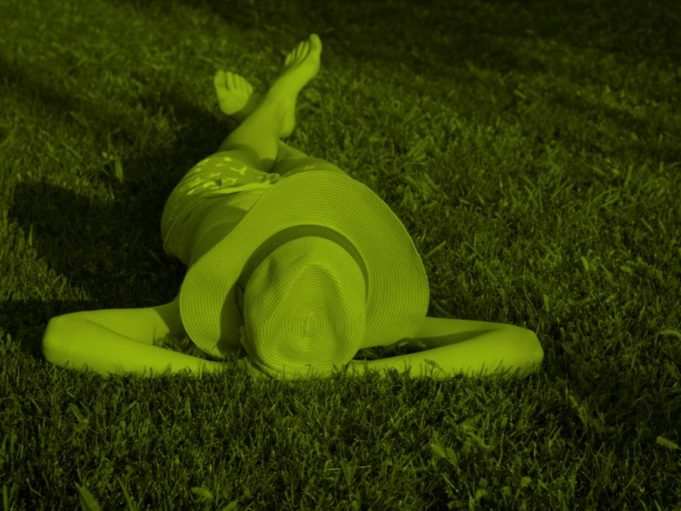
Detailed results:
Contact, comfort level and perceptions of sexual minorities
REPORT PREPARED FOR FONDATION JASMIN ROY

Slide 13
Contact with various minority groups
Base: Total respondents n=800
Q100. In your day to day life, do you regularly spend time with the following types of people in the following environments?

Slide 14
Contact with various minority groups
Base: Total respondents n=800
 | TOTAL | AGE
(%)
 |  | 15-17 | 18-24 | 25-54 | 55+
n= | 800 | 95 | 198 | 300 | 207
People of a religious faith that is different from yours | 64 | 65 | 66 | 67 | 59
People of a different skin color than yours | 63 | 63 | 80 | 70 | 46
People from an ethnic background that is different from yours | 62 | 68 | 70 | 65 | 55
People who are homosexual or bisexual | 56 | 46 | 66 | 60 | 47
People with a mental disability | 37 | 40 | 45 | 38 | 31
People with a physical disability | 35 | 41 | 32 | 33 | 39
Transgender people | 9 | 15 | 12 | 9 | 7
Q100. In your day to day life, do you regularly spend time with the following types of people in the following environments?

Slide 15
Contact with various minority groups
Base: Total respondents n=800
 | TOTAL | REGION |  | GENDER |  | BORN IN CANADA
(%)
 |  | Quebec | Canada hors QC | Man | Woman | Yes | No
n= | 800 | 190 | 610 | 347 | 453 | 667 | 133
People of a religious faith that is different from yours | 64 | 51 | 68 | 64 | 64 | 66 | 55
People of a different skin color than yours | 63 | 61 | 63 | 62 | 63 | 65 | 53
People from an ethnic background that is different from yours | 62 | 53 | 65 | 59 | 65 | 63 | 55
People who are homosexual or bisexual | 56 | 70 | 51 | 51 | 60 | 59 | 42
People with a mental disability | 37 | 35 | 37 | 33 | 41 | 39 | 28
People with a physical disability | 35 | 31 | 37 | 31 | 40 | 38 | 24
Transgender people | 9 | 5 | 10 | 7 | 10 | 9 | 8
Q100. In your day to day life, do you regularly spend time with the following types of people in the following environments?

Slide 16
Environment where contact with various minority groups occurs
Base: Total respondents n=800
People who are homosexual or bisexual
Transgender people
People of a different skin color than yours
People with a physical disability
Q100. In your day to day life, do you regularly spend time with the following types of people in the following environments?

Slide 17
Comfort level when interacting with various minority groups
Base: Total respondents n=800
Total comfortable
93%
91%
90%
86%
86%
82%
88%
76%
60%
People …
Q101. Generally speaking, in your daily life, to what extent are you comfortable or uncomfortable when spending time with the following types of people?

Slide 18
Comfort level when interacting with various minority groups
Base: Total respondents n=800
 | TOTAL | AGE
(%) Very comfortable
 |  | 15-17 | 18-24 | 25-54 | 55+
n= | 800 | 95 | 198 | 300 | 207
People of a different skin color than yours | 68 | 65 | 75 | 68 | 65
People from an ethnic background that is different from yours | 61 | 62 | 66 | 61 | 58
People of a religious faith that is different from yours | 52 | 54 | 58 | 52 | 50
People who are homosexual or bisexual | 52 | 40 | 65 | 55 | 44
People who are homosexual or bisexual and of the opposite gender | 52 | 42 | 65 | 55 | 43
People who are homosexual or bisexual and of the same gender as you | 48 | 39 | 60 | 52 | 40
People with a physical disability | 43 | 39 | 40 | 42 | 47
People with a mental disability | 27 | 30 | 28 | 31 | 21
Transgender people | 26 | 29 | 43 | 28 | 18
Q101. Generally speaking, in your daily life, to what extent are you comfortable or uncomfortable when spending time with the following types of people?

Slide 19
Comfort level when interacting with various minority groups
Base: Total respondents n=800
 | TOTAL | REGION |  | GENDER
(%) Very comfortable
 |  | Quebec | Canada hors QC | Man | Woman
n= | 800 | 190 | 610 | 347 | 453
People of a different skin color than yours | 68 | 64 | 69 | 60 | 75
People from an ethnic background that is different from yours | 61 | 50 | 64 | 56 | 65
People of a religious faith that is different from yours | 52 | 40 | 55 | 43 | 60
People who are homosexual or bisexual | 52 | 57 | 50 | 44 | 60
People who are homosexual or bisexual and of the opposite gender | 52 | 53 | 51 | 43 | 61
People who are homosexual or bisexual and of the same gender as you | 48 | 49 | 48 | 42 | 54
People with a physical disability | 43 | 41 | 44 | 39 | 48
People with a mental disability | 27 | 25 | 28 | 25 | 29
Transgender people | 26 | 25 | 27 | 19 | 33
Q101. Generally speaking, in your daily life, to what extent are you comfortable or uncomfortable when spending time with the following types of people?

Slide 20
Comfort level when interacting with various minority groups
Base: Total respondents n=800
 | TOTAL | BORN IN CANADA
(%) Very + fairly comfortable
 |  | Yes | No
n= | 800 | 667 | 133
People of a different skin color than yours | 93 | 93 | 93
People from an ethnic background that is different from yours | 91 | 91 | 92
People of a religious faith that is different from yours | 90 | 89 | 92
People who are homosexual or bisexual | 86 | 87 | 78
People who are homosexual or bisexual and of the opposite gender | 86 | 87 | 79
People who are homosexual or bisexual and of the same gender as you | 82 | 84 | 70
People with a physical disability | 88 | 89 | 83
People with a mental disability | 76 | 77 | 67
Transgender people | 60 | 61 | 58
Q101. Generally speaking, in your daily life, to what extent are you comfortable or uncomfortable when spending time with the following types of people?

Slide 21
Comfort level with public displays of affection by people of opposing sex
Base: Total respondents n=800
Total comfortable
94%
88%
80%
72%
Q105. Now, to what extent are you comfortable or uncomfortable with each of the following situations:

Slide 22
Comfort level with public displays of affection by people of the same sex
Base: Total respondents n=800
Total comfortable
81%
75%
62%
56%
Q105. Now, to what extent are you comfortable or uncomfortable with each of the following situations:

Slide 23
Comfort level with using the same toilets or changing rooms as transgender people
Base: Total respondents n=800
Total comfortable
66%
61%
58%
55%
Q105. Now, to what extent are you comfortable or uncomfortable with each of the following situations:

Slide 24
Comfort level with public displays of affection by people of opposing sex
Base: Total respondents n=800
 | TOTAL | AGE
(%) Very comfortable |  | 15-17 | 18-24 | 25-34 | 35-44 | 45-54 | 55+
n= | 800 | 95 | 198 | 87 | 91 | 122 | 207
When you see people of the opposite sex holding hands in public | 68 | 53 | 75 | 61 | 70 | 72 | 66
The idea of children seeing people of the opposite sex holding hands in public | 59 | 44 | 66 | 55 | 64 | 60 | 56
When you see people of the opposite sex kissing on the lips in public | 41 | 35 | 52 | 45 | 37 | 41 | 38
The idea of children seeing people of the opposite sex kissing on the lips in public | 34 | 34 | 45 | 38 | 27 | 33 | 33
Q105. Now, to what extent are you comfortable or uncomfortable with each of the following situations:

Slide 25
Comfort level with public displays of affection by people of opposing sex
Base: Total respondents n=800
 | TOTAL | REGION |  | GENDER |  | BORN IN CANADA
(%) Very comfortable |  | Quebec | Canada hors QC | Man | Woman | Yes | No
n= | 800 | 190 | 610 | 347 | 453 | 669 | 131
When you see people of the opposite sex holding hands in public | 68 | 73 | 66 | 65 | 70 | 70 | 58
The idea of children seeing people of the opposite sex holding hands in public | 59 | 65 | 57 | 52 | 65 | 61 | 49
When you see people of the opposite sex kissing on the lips in public | 41 | 46 | 40 | 43 | 39 | 42 | 37
The idea of children seeing people of the opposite sex kissing on the lips in public | 34 | 41 | 32 | 33 | 35 | 35 | 29
Q105. Now, to what extent are you comfortable or uncomfortable with each of the following situations:

Slide 26
Comfort level with public displays of affection by people of the same sex
Base: Total respondents n=800
 | TOTAL | AGE
(%) Very comfortable
 |  | 15-17 | 18-24 | 25-34 | 35-44 | 45-54 | 55+
n= | 800 | 95 | 198 | 87 | 91 | 122 | 207
When you see people of the same sex holding hands in public | 44 | 31 | 62 | 51 | 55 | 37 | 34
The idea of children seeing people of the same sex holding hands in public | 38 | 29 | 55 | 52 | 43 | 31 | 29
When you see people of the same sex kissing on the lips in public | 27 | 22 | 39 | 38 | 26 | 26 | 19
The idea of children seeing people of the same sex kissing on the lips in public | 25 | 23 | 40 | 35 | 23 | 25 | 19
Q105. Now, to what extent are you comfortable or uncomfortable with each of the following situations:

Slide 27
Comfort level with public displays of affection by people of the same sex
Base: Total respondents n=800
 | TOTAL | REGION |  | GENDER |  | BORN IN CANADA
(%) Very comfortable
 |  | Quebec | Canada hors QC | Man | Woman | Yes | No
n= | 800 | 190 | 610 | 347 | 453 | 669 | 131
When you see people of the same sex holding hands in public | 44 | 43 | 44 | 36 | 51 | 46 | 32
The idea of children seeing people of the same sex holding hands in public | 38 | 37 | 38 | 30 | 46 | 40 | 27
When you see people of the same sex kissing on the lips in public | 27 | 26 | 27 | 25 | 28 | 28 | 23
The idea of children seeing people of the same sex kissing on the lips in public | 25 | 27 | 25 | 22 | 29 | 27 | 18
Q105. Now, to what extent are you comfortable or uncomfortable with each of the following situations:

Slide 28
Comfort level with using the same toilets or changing rooms as transgender people
Base: Total respondents n=800
 | TOTAL | AGE
(%) Very comfortable
 |  | 15-17 | 18-24 | 25-34 | 35-44 | 45-54 | 55+
n= | 800 | 95 | 198 | 87 | 91 | 122 | 207
The idea of a transgender person using the same public toilets as you | 38 | 23 | 50 | 39 | 43 | 37 | 32
The idea of a transgender child using the same toilets as your child at school (or a child you feel close to if you do not have any children yourself) | 36 | 19 | 49 | 37 | 43 | 38 | 28
The idea of a transgender person using the same changing room as you in sports facilities or establishments | 31 | 17 | 41 | 38 | 35 | 34 | 23
The idea of a transgender child using the same changing room as your child at school during physical education classes (or a child you feel close to if you don`t have any children yourself) | 31 | 15 | 43 | 35 | 36 | 35 | 23
Q105. Now, to what extent are you comfortable or uncomfortable with each of the following situations:

Slide 29
Comfort level with using the same toilets or changing rooms as transgender people
Base: Total respondents n=800
 | TOTAL | REGION |  | GENDER |  | BORN IN CANADA
(%) Very comfortable
 |  | Quebec | Canada hors QC | Man | Woman | Yes | No
n= | 800 | 190 | 610 | 347 | 453 | 669 | 131
The idea of a transgender person using the same public toilets as you | 38 | 37 | 38 | 34 | 41 | 40 | 26
The idea of a transgender child using the same toilets as your child at school (or a child you feel close to if you do not have any children yourself) | 36 | 34 | 37 | 32 | 40 | 38 | 29
The idea of a transgender person using the same changing room as you in sports facilities or establishments | 31 | 29 | 31 | 31 | 31 | 32 | 26
The idea of a transgender child using the same changing room as your child at school during physical education classes (or a child you feel close to if you don`t have any children yourself) | 31 | 29 | 32 | 30 | 33 | 32 | 25
Q105. Now, to what extent are you comfortable or uncomfortable with each of the following situations:

Slide 30
Perceptions and stereotypes regarding sexual minorities
Base: Total respondents n=800
Total agree
13%
10%
Q107. To what extent do you agree or disagree with the following statements:

Slide 31
Perceptions and stereotypes regarding sexual minorities
Base: Total respondents n=800
To avoid any risk of inappropriate sexual
conduct, people who are homosexual or
bisexual shouldn’t be allowed to work
with children
Homosexuality is something that is abnormal and
goes against nature
However much love and attention they get, I think a
child cannot develop as well with two parents of the
same sex as if they had two parents of opposing sex
Q104. For each of the following pairs of statements, you have to choose which of the two statements, A and B, you feel closest to by choosing the box that best fits your opinion.

Slide 32
Perceptions and stereotypes regarding sexual minorities
Base: Total respondents n=800
I think the increasingly visible presence of
homosexual, bisexual or transgender people
is undermining the values of our society
I think that a person`s gender (male or female)
is biologically determined at birth and that
people who want to change genders have
a psychological problem
Each person is necessarily a man or a woman
Q104. For each of the following pairs of statements, you have to choose which of the two statements, A and B, you feel closest to by choosing the box that best fits your opinion.

Slide 33
Perceptions and stereotypes regarding sexual minorities
Base: Total respondents n=800
 | TOTAL | AGE
(%) When I am in the presence of a homosexual or bisexual person of the same sex as me, I have a tendency to think they will want to hit on me |  | 15-17 | 18-24 | 25-34 | 35-44 | 45-54 | 55+
n= | 800 | 95 | 198 | 87 | 91 | 122 | 207
Totally agree | 2 | 7 | 3 | 4 | 3 | - | 1
vs
Totally disagree | 54 | 43 | 48 | 53 | 58 | 51 | 59
(%) I have the impression that if someone is in regular contact with a homosexual, bisexual or transgender person, they can become one themselves
Totally agree | 2 | 9 | 5 | 5 | 2 | - | -
vs
Totally disagree | 70 | 57 | 64 | 67 | 75 | 65 | 73
Q107. To what extent do you agree or disagree with the following statements:

Slide 34
Perceptions and stereotypes regarding sexual minorities
Base: Total respondents n=800
 | TOTAL | REGION |  | GENDER |  | BORN IN CANADA
(%) When I am in the presence of a homosexual or bisexual person of the same sex as me, I have a tendency to think they will want to hit on me |  | Quebec | Canada hors QC | Man | Woman | Yes | No
n= | 800 | 190 | 610 | 347 | 453 | 669 | 131
Totally agree | 2 | 1 | 2 | 2 | 2 | 2 | 4
vs
Totally disagree | 54 | 53 | 55 | 45 | 64 | 57 | 40
(%) I have the impression that if someone is in regular contact with a homosexual, bisexual or transgender person, they can become one themselves
Totally agree | 2 | 1 | 3 | 2 | 2 | 1 | 7
vs
Totally disagree | 70 | 73 | 68 | 59 | 80 | 74 | 49
Q107. To what extent do you agree or disagree with the following statements:

Slide 35
Perceptions and stereotypes regarding sexual minorities
Base: Total respondents n=800
 | TOTAL | AGE
(%) Very close |  | 15-17 | 18-24 | 25-34 | 35-44 | 45-54 | 55+
n= | 800 | 95 | 198 | 87 | 91 | 122 | 207
Homosexual or bisexual people are no more sexually attracted to children than are heterosexuals, and can therefore be just as well trusted to work with children | 66 | 52 | 73 | 75 | 70 | 64 | 61
I think human nature is very diversified and that it`s perfectly normal to have some people who are sexually attracted to people of the opposite sex and others who are attracted to people of the same sex as them | 55 | 46 | 62 | 60 | 60 | 54 | 48
As long as they get love and attention from their parents, I think a child can develop just as well with homosexual parents as with heterosexual parents | 49 | 43 | 62 | 62 | 59 | 38 | 40
Q104. For each of the following pairs of statements, you have to choose which of the two statements, A and B, you feel closest to by choosing the box that best fits your opinion.

Slide 36
Perceptions and stereotypes regarding sexual minorities
Base: Total respondents n=800
 | TOTAL | REGION |  | GENDER |  | BORN IN CANADA
(%) Very close |  | Quebec | Canada hors QC | Man | Woman | Yes | No
n= | 800 | 190 | 610 | 347 | 453 | 669 | 131
Homosexual or bisexual people are no more sexually attracted to children than are heterosexuals, and can therefore be just as well trusted to work with children | 66 | 66 | 66 | 57 | 75 | 69 | 50
I think human nature is very diversified and that it`s perfectly normal to have some people who are sexually attracted to people of the opposite sex and others who are attracted to people of the same sex as them | 55 | 62 | 52 | 48 | 61 | 57 | 43
As long as they get love and attention from their parents, I think a child can develop just as well with homosexual parents as with heterosexual parents | 49 | 43 | 51 | 40 | 57 | 52 | 35
Q104. For each of the following pairs of statements, you have to choose which of the two statements, A and B, you feel closest to by choosing the box that best fits your opinion.

Slide 37
Perceptions and stereotypes regarding sexual minorities
Base: Total respondents n=800
 | TOTAL | AGE
(%) Very close |  | 15-17 | 18-24 | 25-34 | 35-44 | 45-54 | 55+
n= | 800 | 95 | 198 | 87 | 91 | 122 | 207
The increasingly visible presence of homosexual, bisexual or transgender people is proof that the values of our society are becoming more and more humane | 42 | 29 | 52 | 51 | 44 | 32 | 41
It is totally possible that the gender (male or female) that nature assigns someone at birth could be different from the gender the person feels they really belong to | 39 | 26 | 42 | 35 | 39 | 30 | 45
I think that a person's gender is not necessarily binary (male OR female) but that there are different variants of this notion that can also evolve over the course of life | 25 | 14 | 27 | 31 | 29 | 16 | 26
Q104. For each of the following pairs of statements, you have to choose which of the two statements, A and B, you feel closest to by choosing the box that best fits your opinion.

Slide 38
Perceptions and stereotypes regarding sexual minorities
Base: Total respondents n=800
 | TOTAL | REGION |  | GENDER |  | BORN IN CANADA
(%) Very close |  | Quebec | Canada hors QC | Man | Woman | Yes | No
n= | 800 | 190 | 610 | 347 | 453 | 669 | 131
The increasingly visible presence of homosexual, bisexual or transgender people is proof that the values of our society are becoming more and more humane | 42 | 39 | 43 | 36 | 48 | 44 | 31
It is totally possible that the gender (male or female) that nature assigns someone at birth could be different from the gender the person feels they really belong to | 39 | 35 | 40 | 27 | 49 | 40 | 32
I think that a person's gender is not necessarily binary (male OR female) but that there are different variants of this notion that can also evolve over the course of life | 25 | 21 | 26 | 20 | 30 | 26 | 23
Q104. For each of the following pairs of statements, you have to choose which of the two statements, A and B, you feel closest to by choosing the box that best fits your opinion.

Slide 39
Toilets and changing rooms that should be used by transgender students
Base: Total respondents n=800
Q106a. Which toilets do you feel transgender children should use at school?
Q106b. Which changing rooms do you think transgender children should use at school during physical education classes?

Slide 40
Toilets and changing rooms that should be used by transgender students
Base: Total respondents n=800
 | TOTAL | REGION |  | GENDER
(%) |  | Quebec | Canada hors QC | Man | Woman
n= | 800 | 190 | 610 | 347 | 453
The toilets reserved for the gender with which they were born | 19 | 20 | 18 | 24 | 14
The toilets reserved for the gender they identify with | 46 | 53 | 44 | 41 | 51
Mixed toilets reserved for people with special needs (e.g., children with disabilities)) | 17 | 13 | 18 | 17 | 17
Toilets reserved specifically for them | 10 | 8 | 10 | 10 | 10
Other | 8 | 7 | 8 | 8 | 8
Q106a. Which toilets do you feel transgender children should use at school?

Slide 41
Toilets and changing rooms that should be used by transgender students
Base: Total respondents n=800
 | TOTAL | REGION |  | GENDER
(%) |  | Quebec | Canada hors QC | Man | Woman
n= | 800 | 190 | 610 | 347 | 453
The toilets reserved for the gender with which they were born | 19 | 24 | 17 | 23 | 15
The toilets reserved for the gender they identify with | 43 | 52 | 41 | 37 | 50
Changing rooms in which they can be alone or among themselves | 29 | 16 | 33 | 33 | 24
Other | 9 | 8 | 10 | 7 | 12
Q106b. Which changing rooms do you think transgender children should use at school during physical education classes?

Slide 42
Perception of the continued usefulness of awareness-raising efforts against homophobic behaviours
Base: Total respondents n=800
Over the past 20-30 years, Canadian society
has advanced a lot in its acceptance of
homosexuality and homophobic behaviour
and gay bashing has become rare. It is therefore
no longer necessary to advocate for gay rights
Q104. For each of the following pairs of statements, you have to choose which of the two statements, A and B, you feel closest to by choosing the box that best fits your opinion.

Slide 43
Perception of the continued usefulness of awareness-raising efforts against homophobic behaviours
Base: Total respondents n=800
 | TOTAL | AGE
(%) Very close |  | 15-17 | 18-24 | 25-54 | 55+
n= | 800 | 95 | 198 | 300 | 207
Over the past 20-30 years, Canadian society has advanced a lot in its acceptance of homosexuality, but there is still a lot to be done to stop homophobic behaviour and gay bashing | 36 | 27 | 39 | 36 | 36
vs.
Over the past 20-30 years, Canadian society has advanced a lot in its acceptance of homosexuality and homophobic behaviour and gay bashing has become rare. It is therefore no longer necessary to advocate for gay rights | 8 | 16 | 11 | 7 | 7
Q104. For each of the following pairs of statements, you have to choose which of the two statements, A and B, you feel closest to by choosing the box that best fits your opinion.

Slide 44
Perception of the continued usefulness of awareness-raising efforts against homophobic behaviours
Base: Total respondents n=800
 | TOTAL | REGION |  | GENDER
(%) Very close |  | Quebec | Canada hors QC | Man | Woman
n= | 800 | 190 | 610 | 347 | 453
Over the past 20-30 years, Canadian society has advanced a lot in its acceptance of homosexuality, but there is still a lot to be done to stop homophobic behaviour and gay bashing | 36 | 32 | 38 | 30 | 42
vs
Over the past 20-30 years, Canadian society has advanced a lot in its acceptance of homosexuality and homophobic behaviour and gay bashing has become rare. It is therefore no longer necessary to advocate for gay rights | 8 | 9 | 8 | 9 | 7
Q104. For each of the following pairs of statements, you have to choose which of the two statements, A and B, you feel closest to by choosing the box that best fits your opinion.

Slide 45
Familiarity with various acronyms
Base: Total respondents n=800
Total Have seen/ heard of acronym
76%
60%
12%
Q102. Have you ever seen the following acronyms :
Q103. Do you know what the following acronyms mean :

Slide 46
Familiarity with various acronyms
Base: Total respondents n=800
 |  | TOTAL | REGION |  | AGE
(%) |  |  | Quebec | Canada hors QC | 15-17 | 18-24 | 25-34 | 35-44 | 45-54 | 55+
 | n= | 800 | 190 | 610 | 95 | 198 | 87 | 91 | 122 | 207
LGBT
Total Have seen/heard |  | 76 | 60 | 82 | 67 | 83 | 83 | 73 | 75 | 75
Yes, very well |  | 57 | 46 | 60 | 42 | 64 | 73 | 55 | 57 | 49
LGBTQ
Total Have seen/heard |  | 60 | 32 | 69 | 58 | 64 | 74 | 54 | 56 | 58
Yes, very well |  | 35 | 18 | 40 | 31 | 46 | 53 | 31 | 32 | 27
LGBTTIQ2S+
Total Have seen/heard |  | 12 | 8 | 13 | 11 | 21 | 23 | 9 | 10 | 8
Yes, very well |  | 3 | 2 | 3 | 3 | 5 | 6 | 4 | 2 | 1
Q102. Have you ever seen the following acronyms :
Q103. Do you know what the following acronyms mean :

Slide 47

Respondent profile
REPORT PREPARED FOR FONDATION JASMIN ROY

Slide 48
Respondent profile
Base: Total respondents
(%) | TOTAL
GENDER n= | 800
Man | 49
Woman | 51
(%) | TOTAL
PROVINCE | 800
Atlantic | 8
Quebec | 24
Ontario | 35
Manitoba / Saskatchewan | 6
Alberta | 13
British Columbia | 14
AGE
15-17 years old | 4
18-24 years old | 11
25-34 years old | 14
35-44 years old | 18
45-54 years old | 19
55 and over | 33
EMPLOYMENT SITUATION
Worker only | 52
Student only | 6
Worker & student | 12
Other | 30
Total workers | 64
Total students | 18
EDUCATION
High school or less | 39
College | 38
University | 23

Slide 49
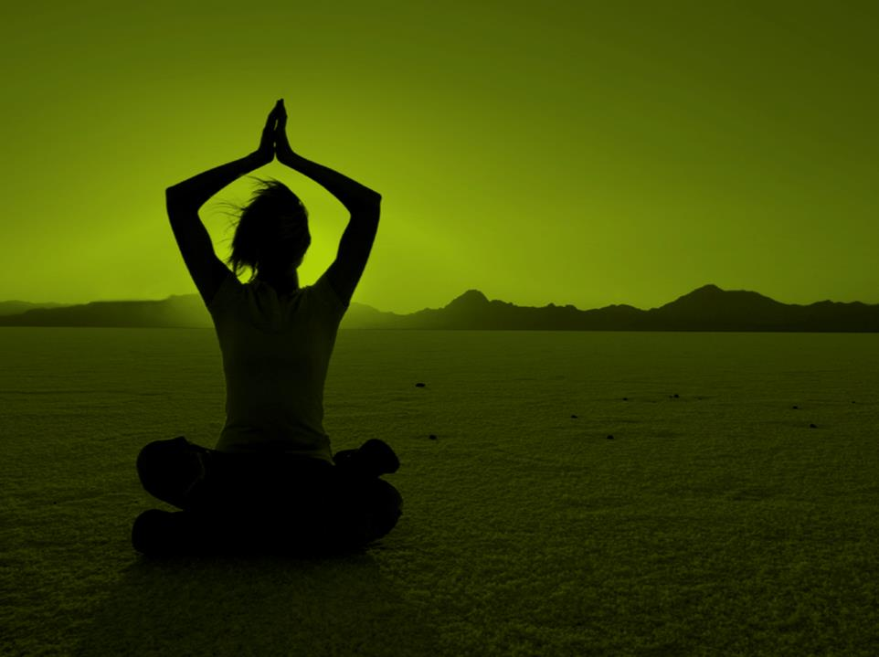
555, RENÉ-LÉVESQUE OUEST
  MONTRÉAL (QUÉBEC) H2Z 1B1
  BUREAU 1501
T 514 849-8086
  WWW.CROP.CA

